Slide 1
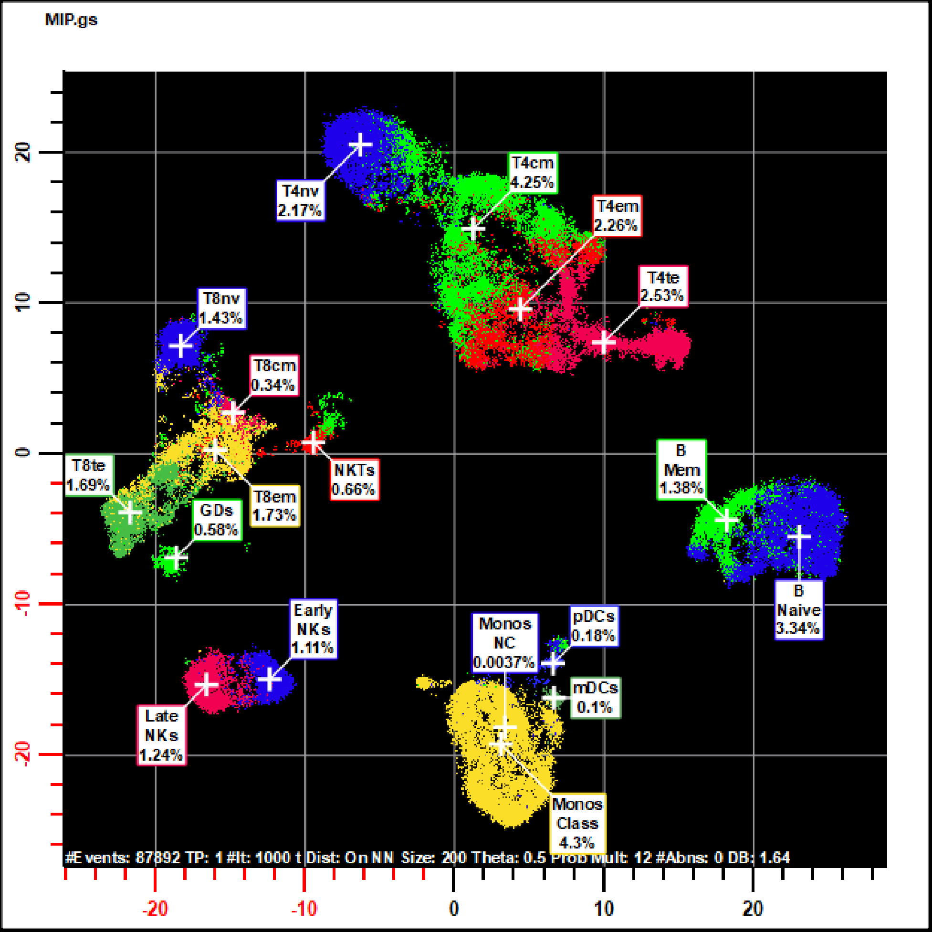
SNE Made Simple June, 2018
C. Bruce Bagwell MD, Ph.D.
Verity Software House
Notes:
Stochastic Nearest Neighbor Embedding (SNE) mapping is one of the most exciting analysis tool we’ve seen in the past decade. The ways this tool can be used is infinite; however, the story behind how and why it works can be told in a relatively short period of time.

Slide 2
Cen-se’ Map Formation Movie (Actual Speed)
29 Correlated Measurements
How can it do that??
Notes:
Here is movie of the formation of a Cen-se’ map showing some key populations in a PBMC sample. Although this algorithm would be considered complex, understanding how and why it does what is does is not as complicated as you might think.

Slide 3
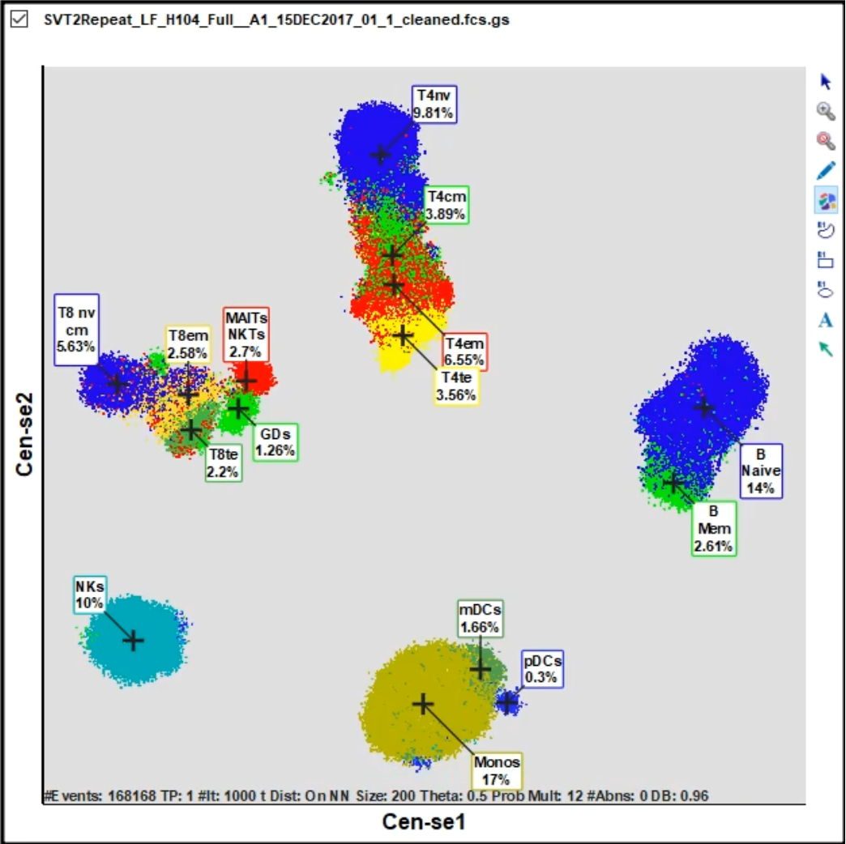
Force-Directed Solution
Let’s just look at one event.
Each event has an x and
y force applied to it which
causes the event to move
along a specific trajectory.
How are these forces
computed?
f_{y}
f_{x}
Now, that’s an interesting
story…
Notes:
If you’re interested in understanding anything, the first step is often to simplify the problem. If we zoom in and look at just one event, the SNE method evaluates x and y forces to move the event along a particular trajectory. How are these forces calculated?

Slide 4
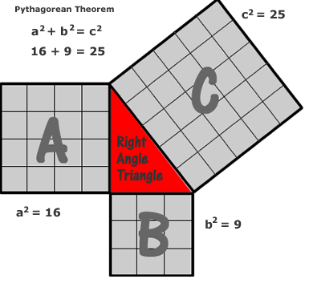
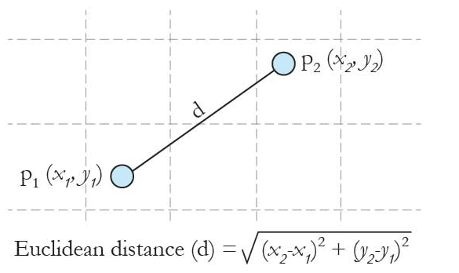
Euclidean Distance
Two Dimensions
Three Dimensions
n Dimensions
Distance scales well with number of dimensions.
Notes:
Before getting too deep into the algorithm, it’s important to define what we mean by Euclidean distance. There won’t be too much mathematics in this presentation, but defining distance does require a little mathematical nomenclature. You might remember that the distance between two points in two dimensions is the square-root of the sum of the x and y differences squared. This equation is a consequence of Pythagorean’s theorem where the summation of the square of two sides of a right-triangle is equal to the hypotenuse squared. It turns out that when we extend the distance concept to three dimensions, it ends up adding just one more term in the square-root. As a consequence, Euclidean distance scales very well with dimensions. The SNE mapping methods use Euclidean distances to quantify the distance between events.

Slide 5
SNE, A Simple Example
High Dimensional Data (>25)
Low Dimensional Data (e.g. 2)
0
2
0
2
Map
1
6
6
8
1
8
7
SNE 2
7
Many Measurements
3
3
5
5
4
4
X
Y
SNE 1
…
Many Measurements
How can we do this?
Notes:
Let’s take a very simple example to explain how SNE methods work. Let’s say we have nine events in very high dimensional space (>25 measurements, see left panel). Each event has a location in this high dimensional space. When we look at the data we can clearly see that the events break into three clusters (events 0, 1, 2; 3, 4, 5; 6, 7, 8). We can also see that the cluster of events 0, 1, 2 are closer to 3, 4, 5 than 6, 7, 8.
What we want to do is to map these points to two or some low-dimensional space and maintain this general pattern (see right panel). Even if these points are not exactly aligned, it would be useful to be able to inspect their patterns.

Slide 6
SNE 1st Step
Data Normalization
Measurement Matrix
Event | Dim 1 (x) | Dim 2 (y) | Dim 3 (Z)
0 | 15 | 17 | 13
1 | 17 | 13 | 15
2 | 13 | 16 | 17
3 | 12 | 15 | 1
4 | 15 | 18 | 3
5 | 13 | 12 | 2
6 | 2 | 15 | 1
7 | 5 | 18 | 3
8 | 3 | 16 | 2
Scaled Zero Mean Data
Event | Dim 1 (x) | Dim 2 (y) | Dim 3 (Z)
0 | 0.42 | 0.14 | 0.63
1 | 0.6 | -0.24 | 0.81
2 | 0.23 | 0.042 | 1
3 | 0.14 | -0.052 | -0.5
4 | 0.42 | 0.23 | -0.31
5 | 0.23 | -0.33 | -0.41
6 | -0.8 | -0.052 | -0.5
7 | -0.52 | 0.23 | -0.31
8 | -0.71 | 0.042 | -0.41
Original Normalization
All measurement means = 0 and
maximum abs deviation from means
is 1.
Notes:
In order to really understand how algorithms work, it’s useful to create very simple examples and follow them through the steps of the algorithm. In this case, I have created nine points in three dimensions (see left table). The very first step in the algorithm is to normalize this data so that the measurements all have the same basic scale. The original algorithm normalized each measurement so that its mean was zero and it scaled all the deviations from the means such that the maximum absolute deviation was 1.

Slide 7
SNE 2nd Step
High Dimensional Data (>25)
Determine a nearest neighbor size.
0
2
The size was originally set by perplexity.
If it were 2, the nearest neighbor size
was set to 3*perplexity or 6.
1
6
8
7
Find the distances between the
events within the neighborhood.
Many Measurements
3
Keep track of the order of the distances.
5
4
When we do this for all events, we
end up with a distance and index
matrix that summarizes all the data.
Many Measurements
Notes:
Let’s begin with event 0 (orange). The second major step in t-SNE is to find all the neighboring events and their distances to each event. We can’t involve all events in this neighborhood because that would require too many calculations for typical cytometry data. In the original algorithm, the nearest neighborhood region was set to be three times something called perplexity. We’ll discuss this term more in a few moments. Once the neighborhood size was determined, one of the algorithms finds all the nearest-neighbor distances to each event. The algorithm keeps track of not only the distances but also sorts them from near to far. This is done for all events and results in a special matrix called the nearest-neighbor matrix.

Slide 8
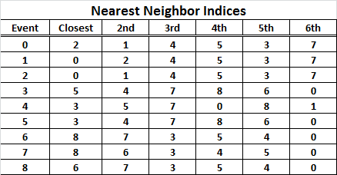
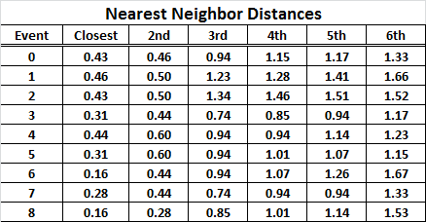
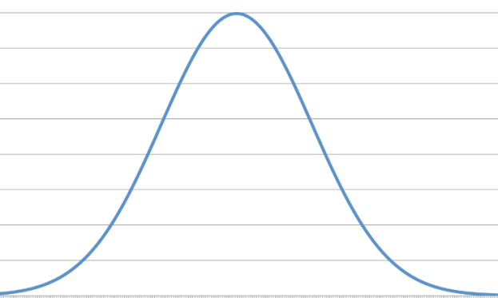
SNE 3rd Step
Change the distances to probabilities.
SD found via
some method
D_{0,1}=0.43
p=0.56
D_{0,2}=0.46
p=0.44
p=very low
Event 0
Event 1
Events 4, 5, 3, 7, 8
Event 2
Notes:
The top-left matrix shows the nearest neighbor indices. The index is the order of the event in the file where event 0 is the first event and 8 is the last. The top-right matrix shows the distances between these nearest neighbor events. Notice that there isn’t a huge difference between the distances between the closest neighbor and the 6th closest neighbor. Also, note that the distances are symmetric. The distance between event 0 and 1 is equal to the distance between event 1 and 0.
Hinton and Roweis in their original SNE paper wanted to change these distances to probabilities to emphasize local structure. The panel in the lower-left shows how this works. If you consider that there is some kernel probability distribution around event 0, you can convert the distances into probabilities. The only thing that you need do is to somehow approximate the standard deviation of this probability distribution.
That’s were the parameter perplexity comes in (see lower-right panel). Perplexity is a kind of geometric mean of entropies. The log of perplexity is entropy, a measurement of disorder. If one assumes that entropy is constant, the standard deviation can be solved for each event. Once the standard deviation is known, the distances in the nearest neighbor distance matrix can be converted to probabilities. The probabilities essentially quantify the degree of similarity between two events and therefore the probability matrix is referred to as the similarity matrix.
Comment… It is usually a mistake to use the same algorithmic parameter for different purposes. A better approach is to have the nearest neighbor size and entropy as two independent parameters. We’ll discuss this further in a few moments.

Slide 9
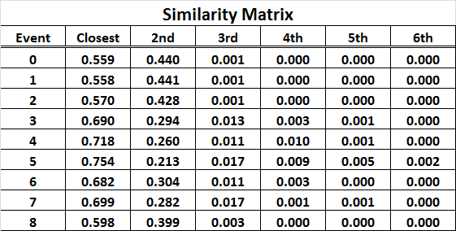
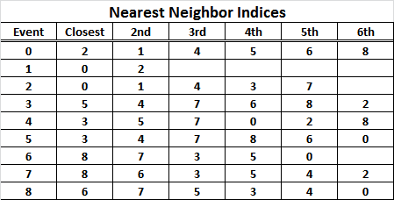
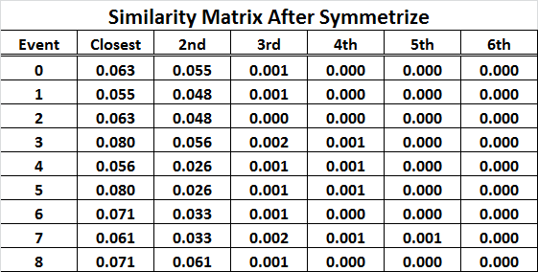
SNE 4th Step
Notice that the matrix now nicely
encodes the local structure of the data.
However, there are a few problems that
need to be rectified.
a) probabilities not symmetric.
e.g. event 0 – 1 0.44 but 1-0 is 0.56.
b) nearest neighbors not always
symmetric.
e.g. event 2 – 4 exists, but 4 – 2 does
not!
The Symmetrize Algorithm
Fixes These Issues
Notes:
The similarity matrix nicely encodes the local structure of the data. Notice that events 0, 1, 2 all have similar similarities as well as groups 3,4,5 and 6, 7, 8. However, the matrix has a few problems that need to be rectified. Because the probability standard deviations were approximations, the probabilities are no longer symmetric (see event 0, 1 vs. 1, 0). Also, the nearest neighbor events are not always symmetric. For example event 2 has 4 as a neighbor but 4 does not have 2. The Symmetrize algorithm fixes these problems. The algorithm that will do the mapping requires that these matrices have symmetry.

Slide 10
SNE 5th Step
High Dimensional Data (>25)
Low Dimensional Data (e.g. 2)
0.06
0
2
0.07
0.06
0.001
1
0.05
6
0.03
8
0.002
7
SNE 2
2
7
3
0.001
5
6
Many Measurements
0.08
0.06
8
0
1
4
3
0.06
5
4
0.03
p_{i,j}
q_{i,j}
SNE 1
Many Measurements
The associated SNE points
are initially randomly placed
in a very small area centered
in the plot.
Notes:
After the similarities are properly symmetrized, the matrix encodes the high-dimensional relationships that existed in this sample data. Not only is the local structure between the points encoded but there is also some regional structure encoded depending on the number of neighbors for each event.
The original SNE algorithm randomly placed the mapped points in a very small spot at the origin of the SNE map (top-right). The reason for making this random was so that the routine would not get stuck into some false minimum value and to give all the low-dimensional points a different starting point.
The next problem was how can the points be moved such that that the similarity probabilities in low dimensional space match up with those in high-dimensional space.

Slide 11
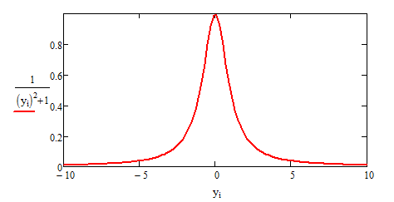
SNE->t-SNE 6th Step
Change the SNE mapped distances to probabilities.
Normal Distribution
t-Distribution 1df (Cauchy Distribution)
D_{0,1}=0.43
p=0.56
p=0.56
p=0.44
p=0.44
D_{0,2}=0.46
p=very low
p=very low
Event 1
Event 0
Events 4, 5, 3, 7
Event 1
Events 4, 5, 3, 7
Event 2
Event 0
Event 2
Too slow
Crowding/Squeezing
Efficient
Compensates for Crowding/Squeezing
Notes:
The original SNE algorithm also used a normal distribution for the low-dimensional kernel. What Laurens observed was that the mapping had a tendency to crowd out the high similarity events. Those events that were distant would tend to shrink or crowd the nearest neighbor events when they were put on scale thus losing the visualization of local structure. If, however, the probabilities were determined from a t-distribution with 1 degree-of-freedom, the long tails nicely compensated for this crowding effect. The t-distribution expanded the high similarity local structure events and contracted the low similarity events in a manner very similar to cytometry’s use of log transforms to expand low intensity measurements and contract high intensity measurements.

Slide 12
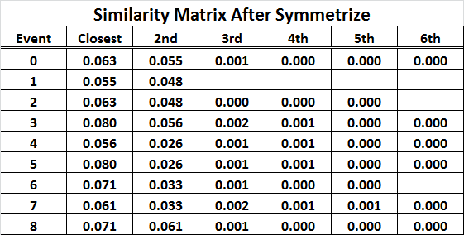
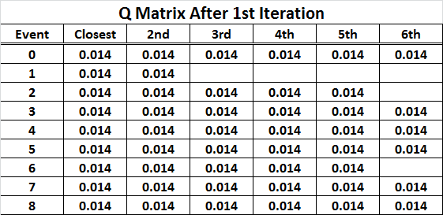
t-SNE 7th Step
High-Dimensions
Low-Dimensions
D_{KL} = 46.24
How do you quantify the difference between these two sets of probabilities?
Kullback-Leibler Divergence (D_{KL}).
Quantifies the loss of information approximating p with q.
Notes:
We now have two sets of similarity probabilities -those that exist in high-dimensional space (see top-left panel) and those that exist in low dimensional space (see top-right panel). The difference between the two sets of probabilities can be quantified by the Kullback-Leibler Divergence formula shown below. If you look at the formula carefully, you can appreciate that if q_{ij} ends up being very close to p_{ij}, the ratio will be close to 1 and the log will be zero. Also, if p_{ij} is very small, then it will have negligible contribution to D_{KL}. Thus, this function can be used as an objective function that quantifies the difference between the two sets of probabilities. Now, how can we reposition the low-dimensional points to minimize the D_{KL}?

Slide 13
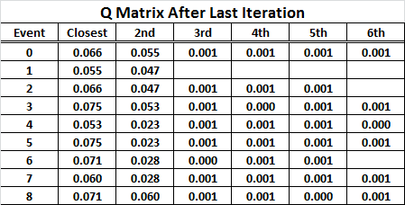
t-SNE 8th Step
p_{i,j}
Initial t-SNE Y Positions
2
7
3
5
8
6
1
0
4
Attraction Forces on Event 0.
Now
Match
Pushes similar events together
q_{i,j}
Only nearest neighbors
All points (n²). Needs
Barnes Hut Approximation
Repulsion Forces on Event 0.
Pushes events outward
4
7
5
6
3
1
8
0
2
Notes:
Let’s first consider how we can move event 0 in the direction such that p and q become a little more similar. A positive force gradient can be computed by differentiating the KLD formula with respect to the Y position of event 0 (see green formula). Event 0 will be mainly attracted to events 1 and 2. The negative force gradient is shown in red and is computed between event 0 and all the points. The net result will be that event 0 will be moving away from the cluster of points but will be approaching points 0 and 1 because of their similarity. When this computation is done for all points many times, the points tend to expand but the similar points tend to aggregate together. After many iterations (~1000), the p and q matrices will end up having very similar probabilities.

Slide 14
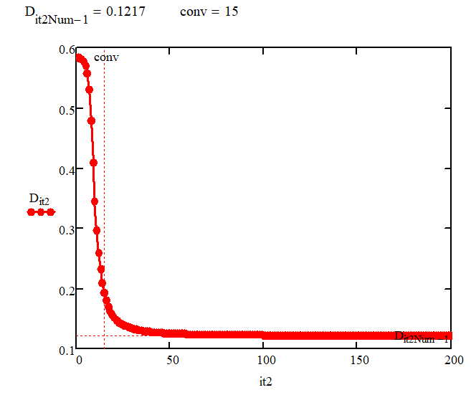
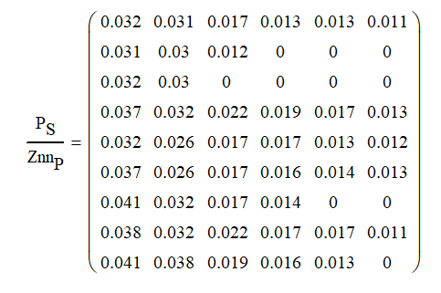
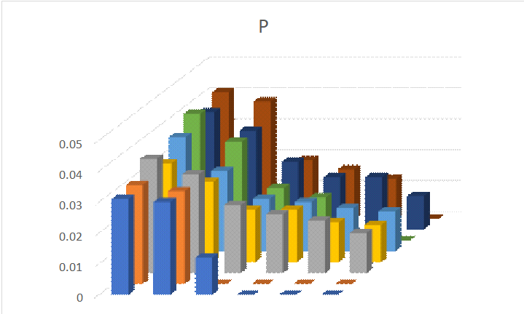
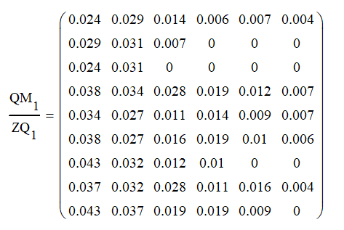
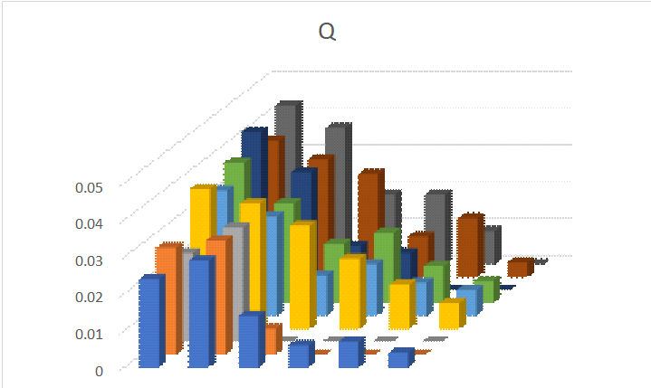
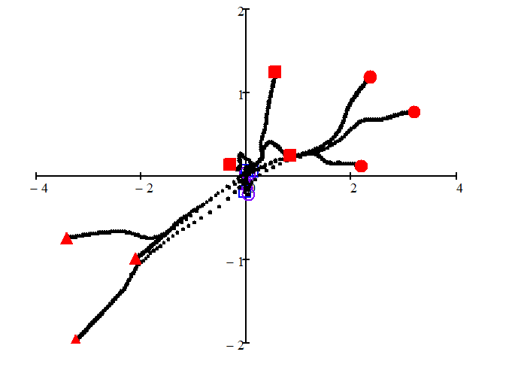
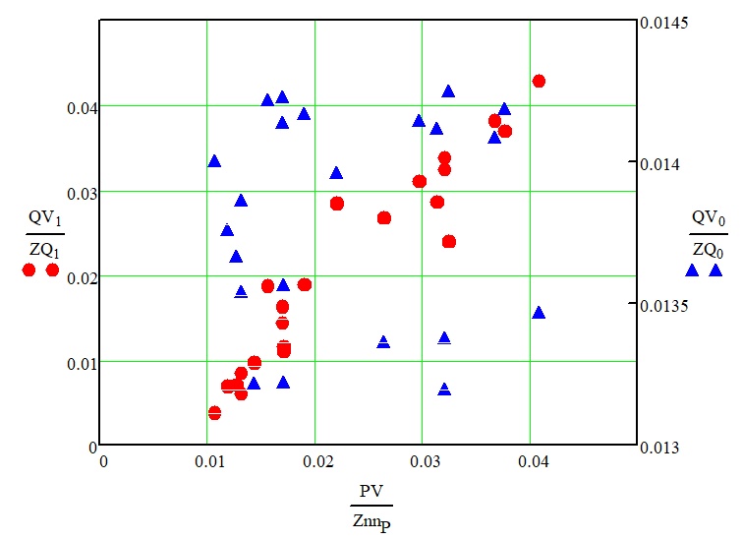
Iterations, Similarities, Trajectories, Correlations
HD
Similarities
D_{KL} ->
LD
Similarities
Iteration ->
Before & After Similarity Correlations
Point Trajectories

Slide 15
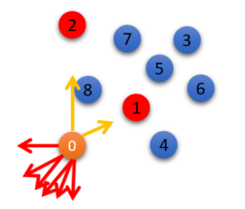
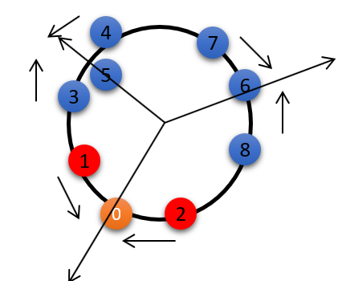
Cen-se’ Map Formation Movie (Actual Speed)
Repulsion>>Attraction
Expand and Aggregate
Starts with 12x attraction.
Then, relaxes that constraint.
Maps all events
in less than 1 minute

Slide 16
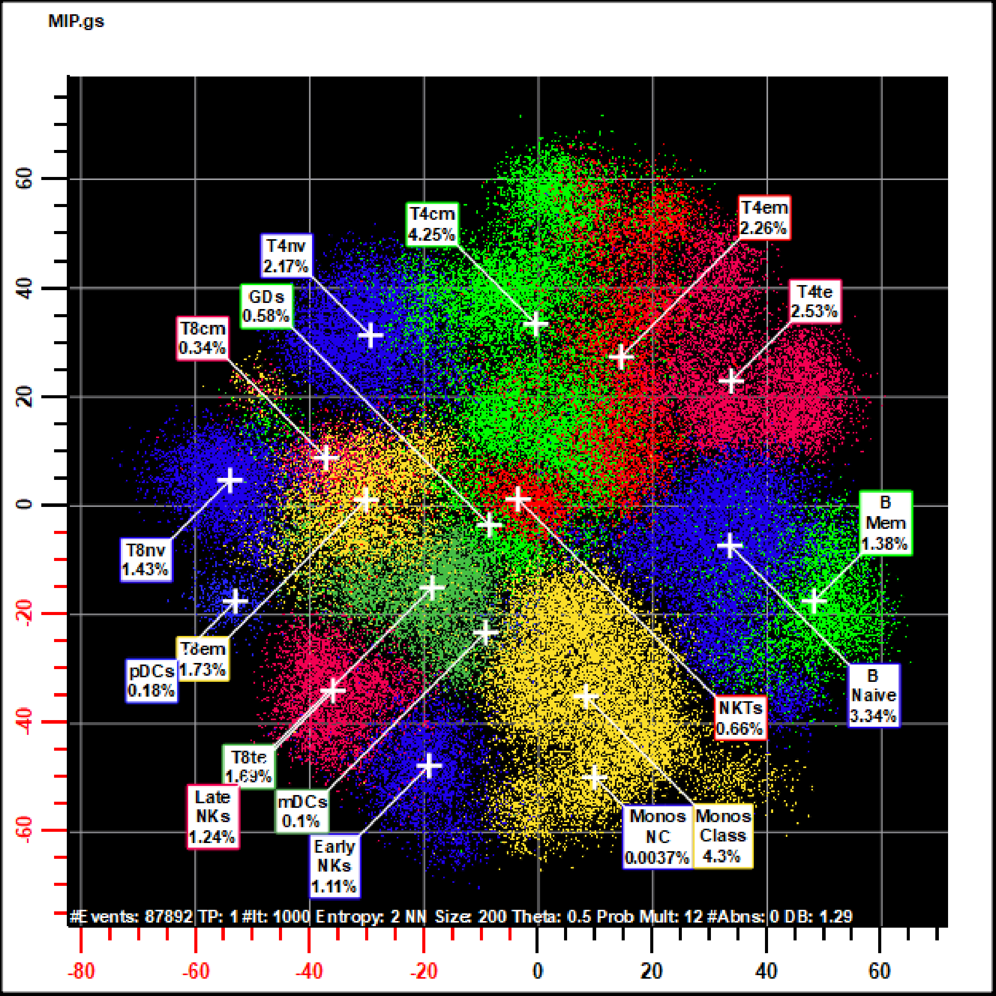
t-SNE and Cen-se’ Mapping
t-SNE Mapping
Same Data
Cen-se’ Mapping
Preserves Data’s Local Structure
Preserves Local and Regional Structure
High-Dimensional
Similarities
Cauchy Enhanced Nearest-neighbor
Stochastic Embedding
New Similarity
Equations
Equals
Low-Dimensional
Similarities
Notes:
This slide compares typical t-SNE patterns compared to Cen-se’ mapping patterns with the same data.

Slide 17
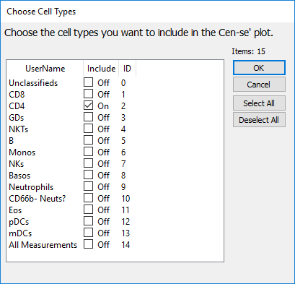
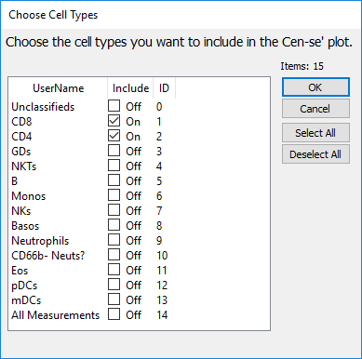
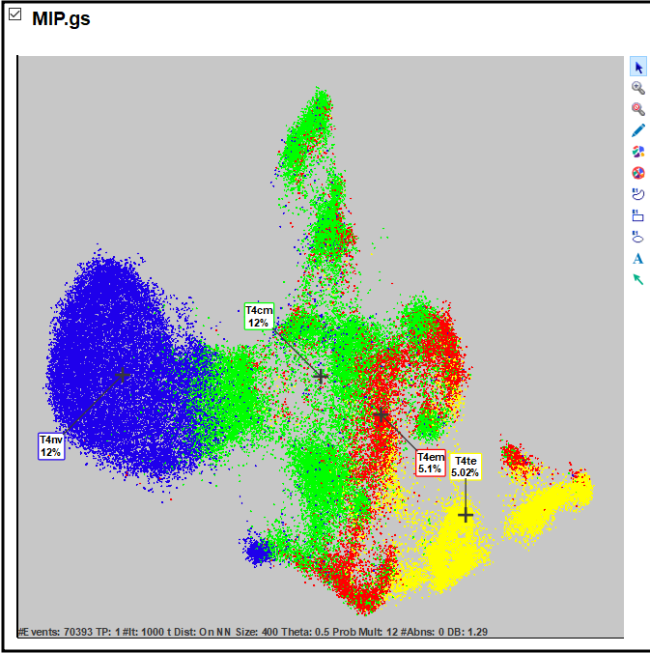
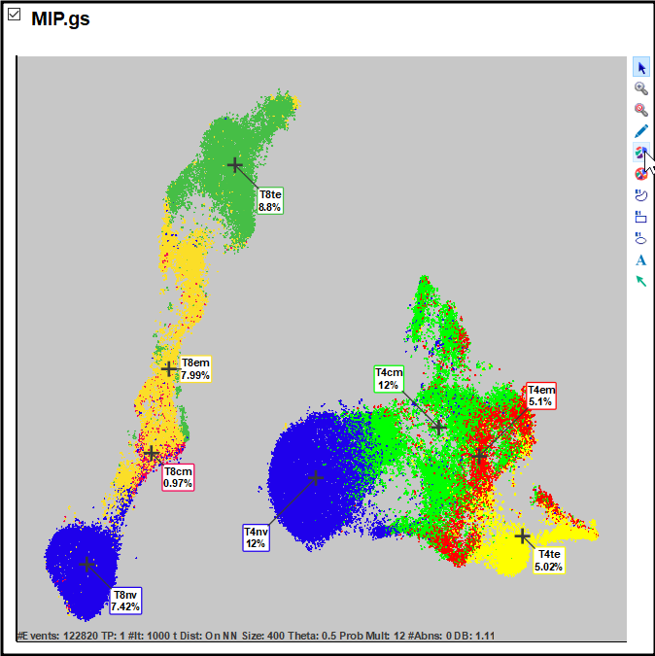
Cell Type Selected Cen-se’ Maps
Choose CD4 T Cells
Choose CD4 and CD8
T Cells

Slide 18
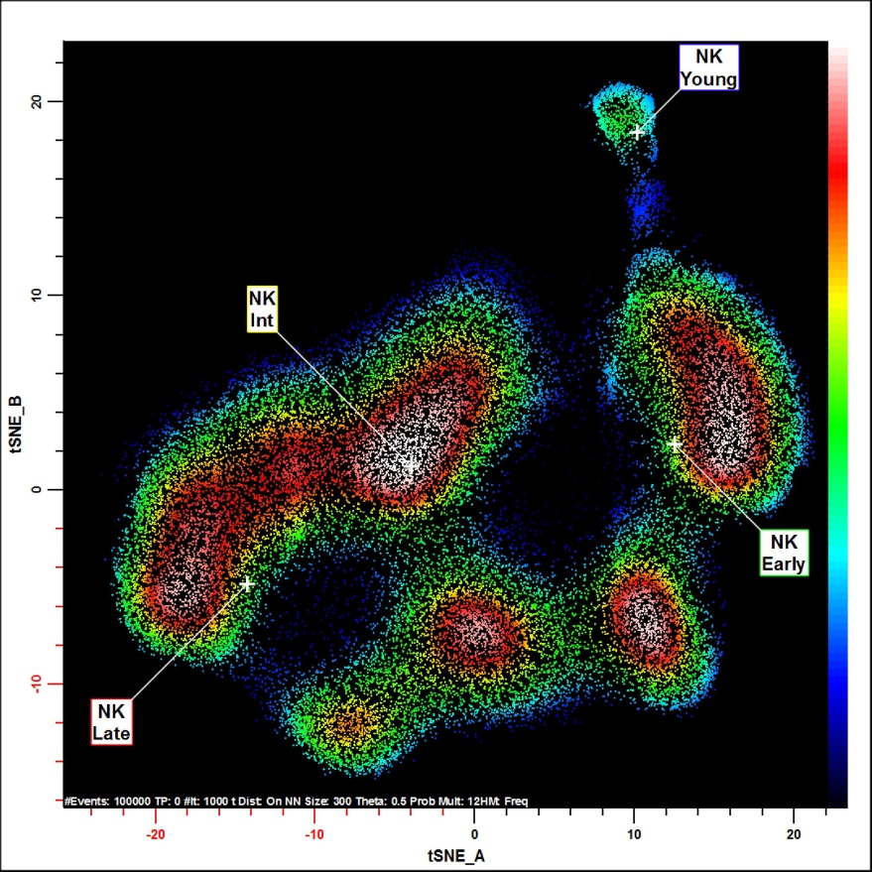
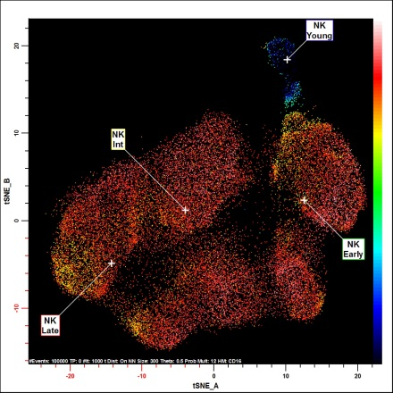
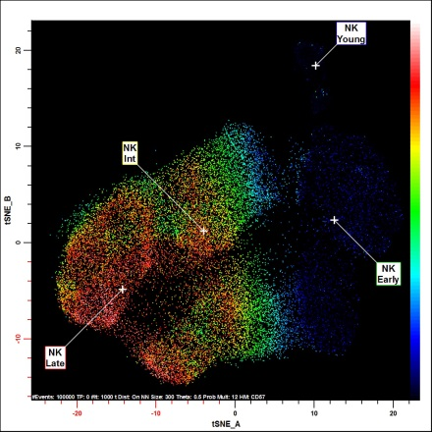
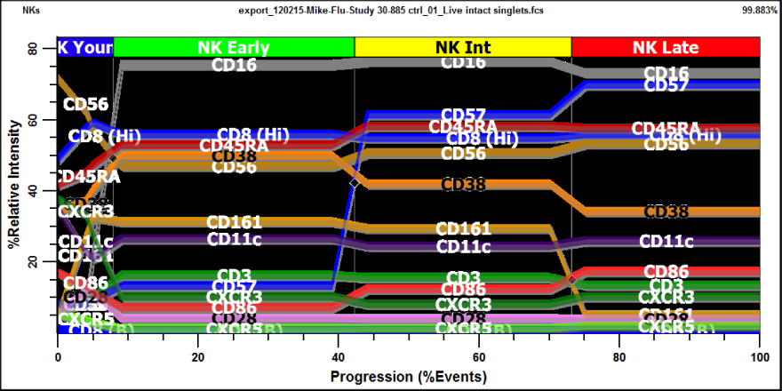
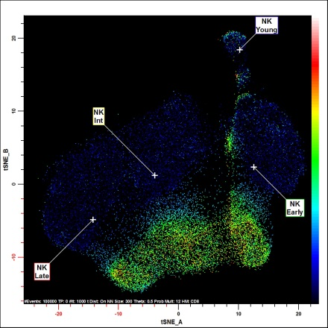
Some Beautiful Maps – The NK Story
A
C
Young NKs
CD16->+
CD8-CD57-
CD8-CD57+
CD16
D
CD8+CD57+
CD8+CD57-
CD57
B
E
CD8
Notes:
Modeling NK Cells. Figure A shows a Cen-se’ map based on 36 measurements of NK cells. Selection of the NK cell type is CD33- CD14- CD3- CD123- Inv(CD56-). The population labelled as NK Young is CD16- CD56++ (see panel B for expression profile overlays and panel C for CD16 heat map. The next stages are (Early) CD16+CD57- CD161+> (Int) CD16+CD57+CD161+ and (Late) CD16+CD57+CD161+ and the other stage related marker intensities are summarized in panel B. This sample has a biphasic expression of CD8 forming two bands in the HD t-SNE map (see panels A and E).

Slide 19
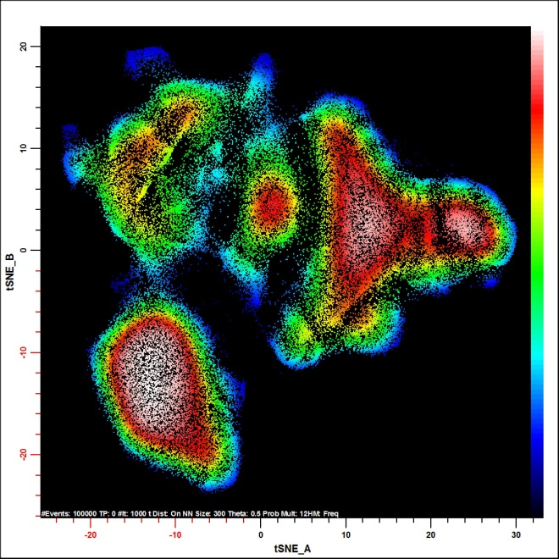
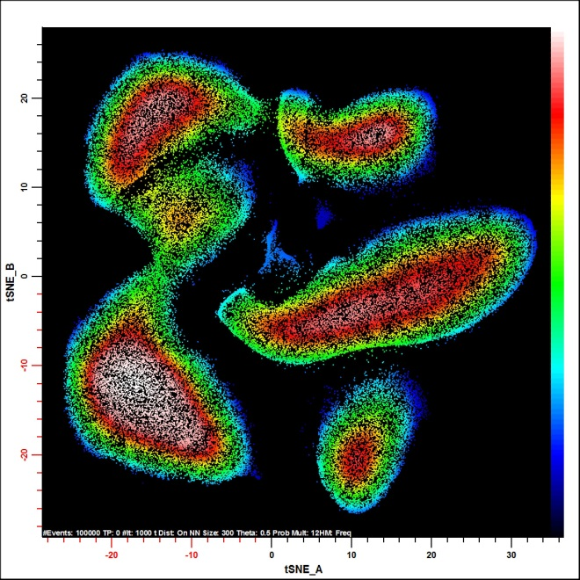
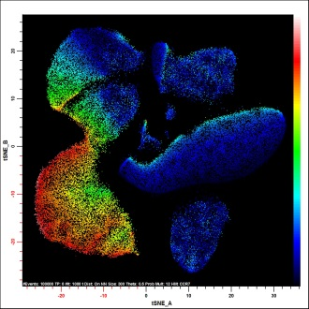
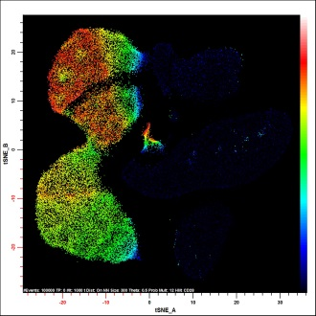
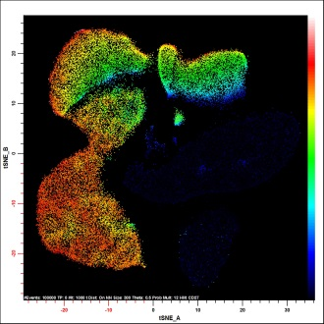
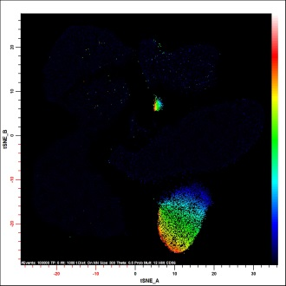
Some Beautiful Maps – The Real CD8 T Cell Stages
A
30-885
B
TM
CD45RA⁻
CD28⁺
EM
CD28⁻
CD27⁺
CM
CD45RA^{d}
CCR7^{+/-}
TE
CD28⁻
CD27⁻
CD56⁻
Nv
CD45RA⁺
CCR7⁺
CD28⁻
CD27⁻
CD56⁺
Prob
All Measurements
Prob
CCR7, CD27,28,45RA,56
C
D
E
F
CCR7
CD28
CD27
CD56
Notes:
Optimizing CD8 T Cell Staging. Figure A shows a Cen-se’ map of CD8 T cells for one donor sample using 36 measurements. Figure B shows the same sample as shown in Figure A with only CCR7, CD28, CD27, CD45RA, and CD56 involved in the mapping. White lines separate the map’s obvious similarity domains and labels indicate the domain’s key phenotypes.
Panels C, D, E, and F show the associated CCR7, CD28, CD27, and CD56 heat map displays. The CD28, CD27, and CD56 measurements are clearly delineated by the gaps in the Cen-se’ map; whereas, CCR7+ portion of the heat map only partially fills the contained domain. The progressive nature of the heat maps confirms that they are demarcating a valid progression.

Slide 20
Summary
t-SNE and Cen-se’ Map high-dimensional data to low-dimensions.
The algorithms try to preserve local and regional (Cen-se’) information.
They yield important information on cell maturation and differentiation.
They will likely used more and more for virtually all cytometry applications.
Don’t be surprised if you see it in sorters in the future.

